Slide 1
Indy-12 Student Budget App (Frugal U)
-The complete app for maintaining a budget as a college student.
-Half of college students don’t even know what a budget is!
-Maintaining good financial habits help you reduce spending, therefore increasing your money pocketed each month.

Slide 2
Documentation Aspect for the App
App Functionality based off Requirements
Users are able to create an account with their name, college, income amount and pay period. Also are able to log in to the created account.
Users are able to add expenses to the app under predetermined categories.
Users are able to see their profile, distribution on their expenses on a pie-chart on the homepage, and are able to reset their account/budget style whenever they want.
Users are able to use a tab with financial and budgeting resources to interact with that’s always updating.
Backend Design of the App
The app used a firebase database system this was useful because of the speed, real time dynamic updates and security element.
The resource API used a strapi server which contains financial and budgeting advice content.
We used Expo, React native, and typescript to program that mobile app. It’s available to download via Github and will be deployed to the app store for IOS/Android.

Slide 3
Recap of This App
This app is a student budget mobile app for the average college student.
It doesn’t have expenses for all possible things, like calculating the best way to setup a mortgage for a house, but for simple budgeting expenses a college student would have. These are things like: Food, tuition, transportation costs, dorm rent/ apartment rent, school supplies.
It’s a basically a myfitnesspal logging calendar but for budgeting.

Slide 4
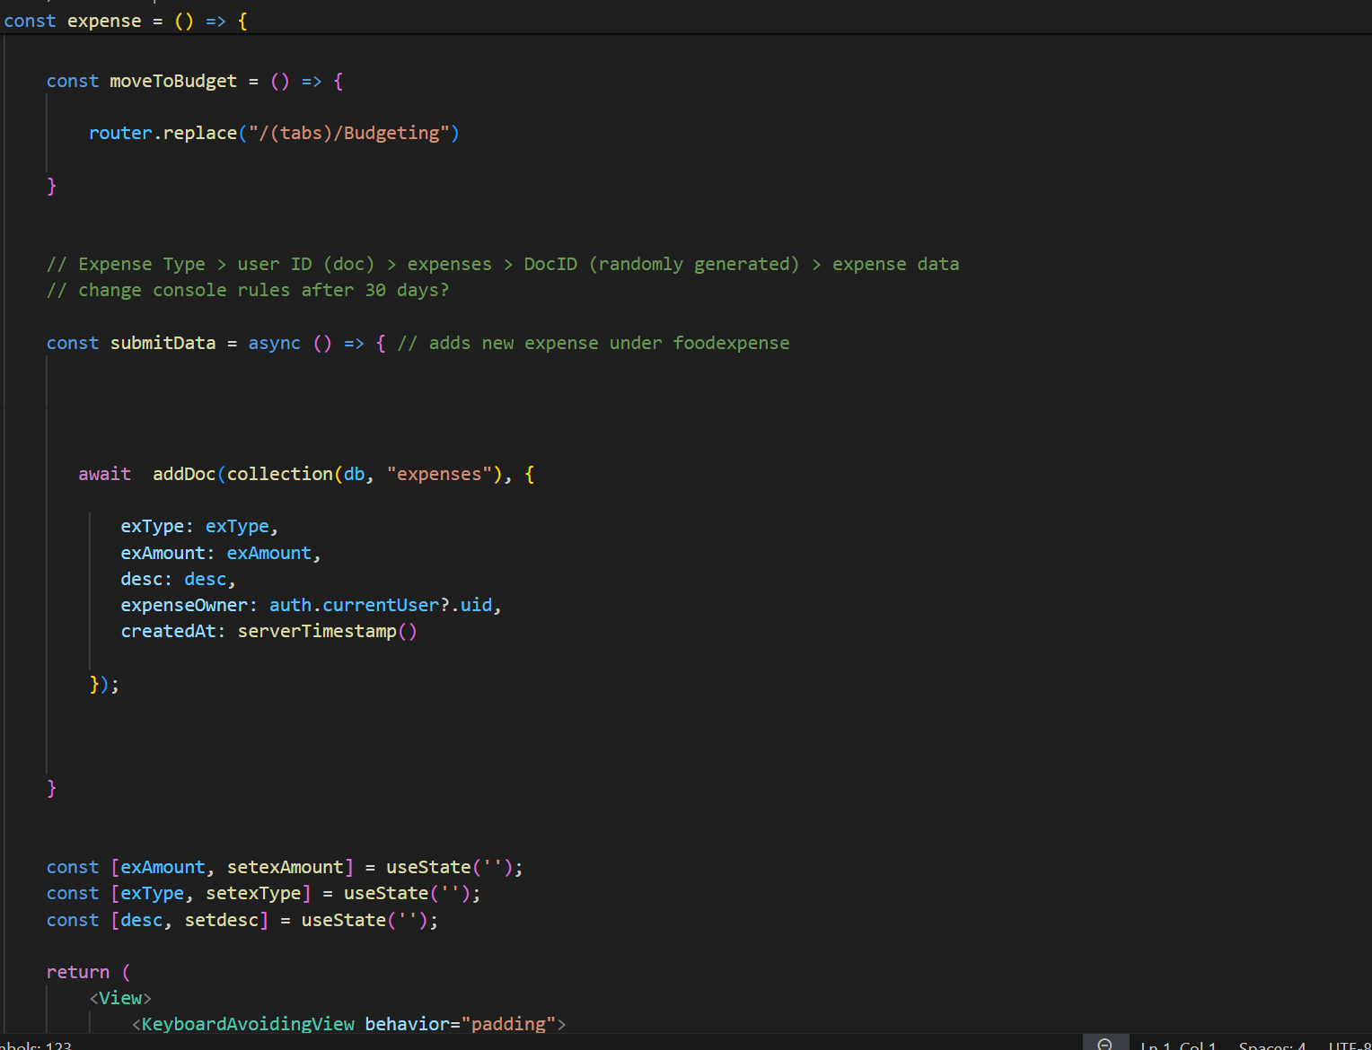
Code Example
Here’s some code for the main budgeting aspect. This is what makes adding expenses work.

Slide 5
The Resource API
It was mentioned that there’s an API to grab entries from a strapi server.
This part of the two-prong database style that was used. Strapi, along with firebase was how all data was stored and fetched for the app.
The Resource API has two buttons that each lead to two separate screens, one for financial advice, one for budgeting advice.
It uses a stack navigation system and the fetch api call to display content entries from the server directly to whichever data the user wanted to see.

Slide 6
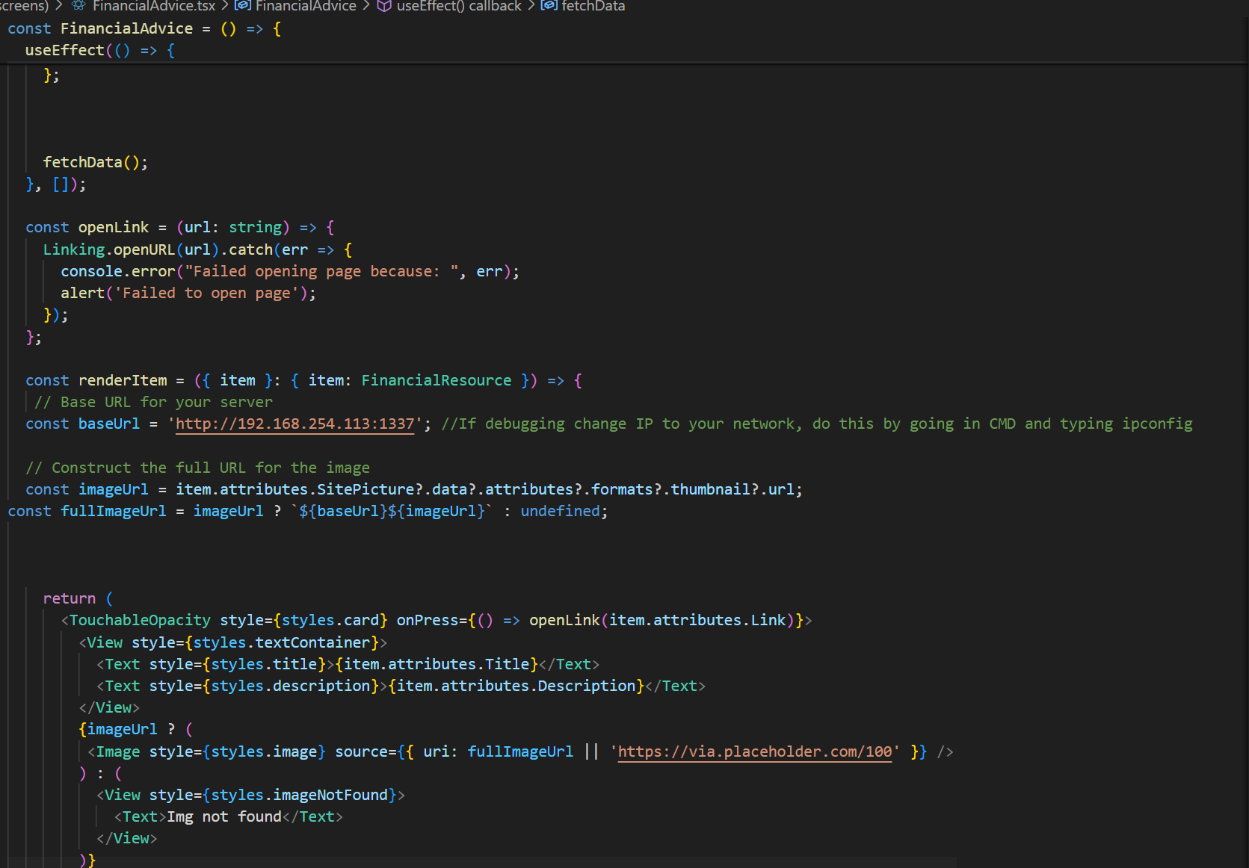
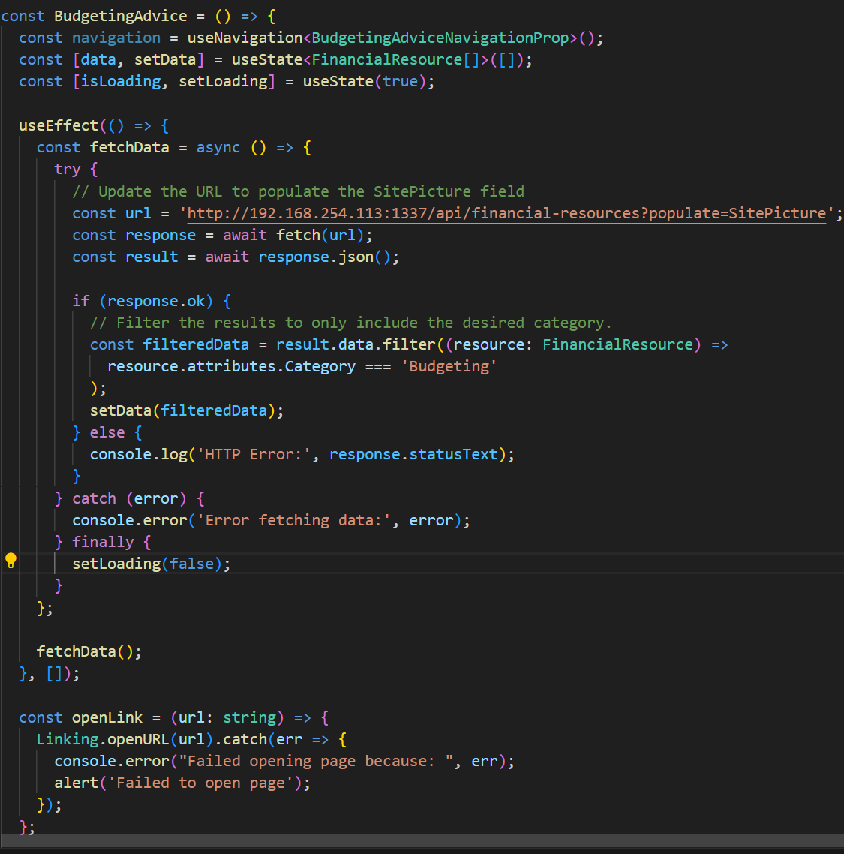
Example code from each of the Two Screens
Financial Advice Screen
Budgeting Advice Screen

Slide 7
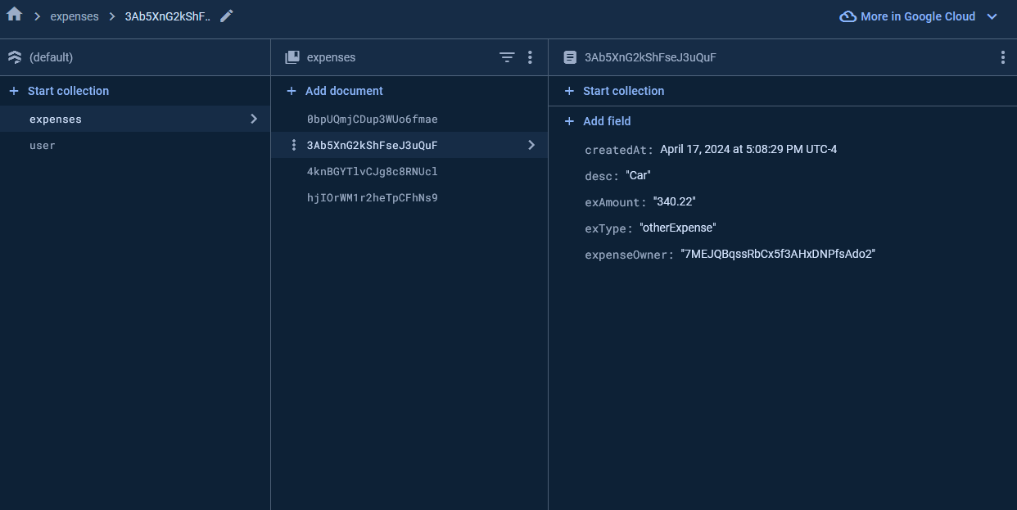
Components
Visual Studio Code
Used as our IDE to write source code
Github
Team collaboration and version control
React native
Utilized react native components to create app features for both platforms
Expo
To test, develop, and deploy the application on our devices
Firebase
Firebase authentication for account creation and login as well as encryption
Firestore used for database to store user expenses and account information

Slide 8
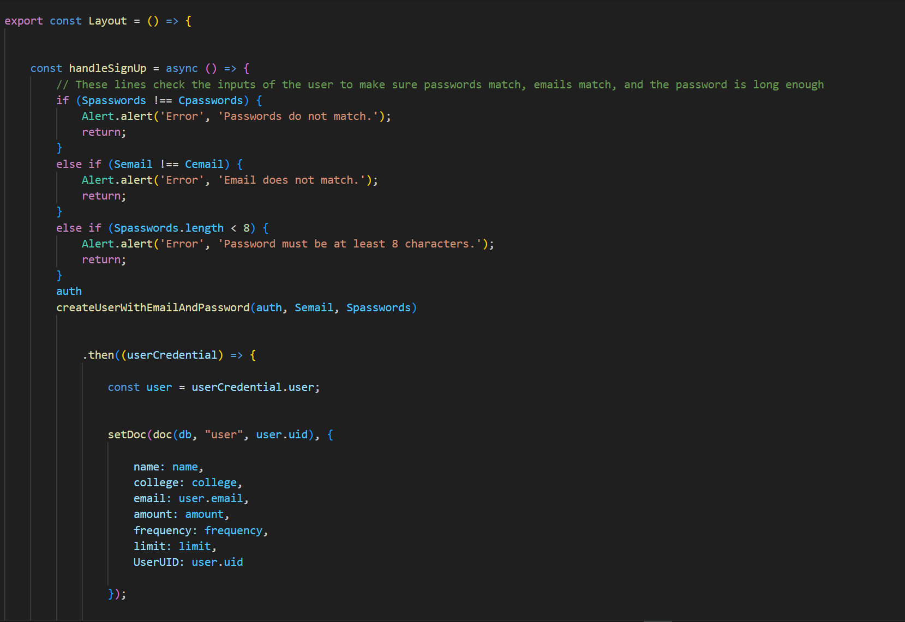
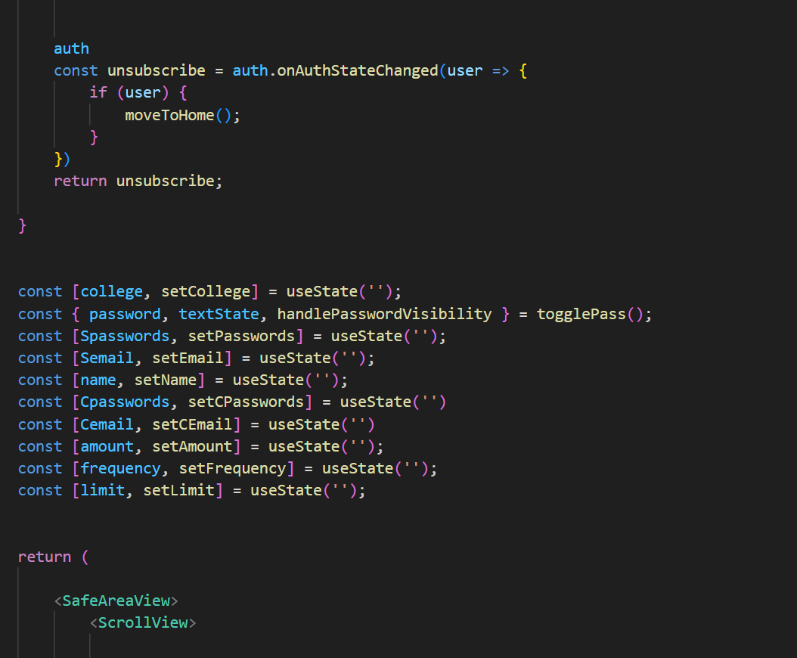
Code from Account creation part of the App
To show how a user is created and saved to the database.
User being created and Signup being handled.
User variables being created and user being authenticated.

Slide 9
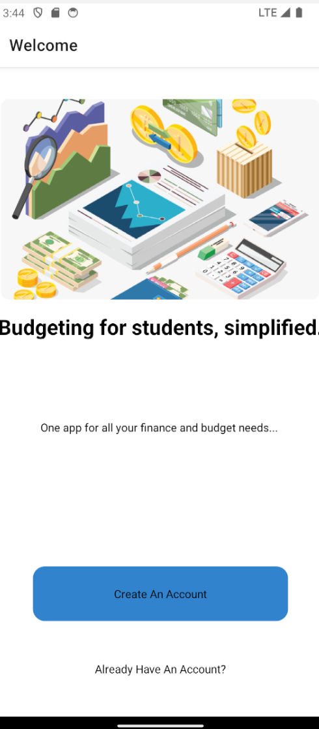
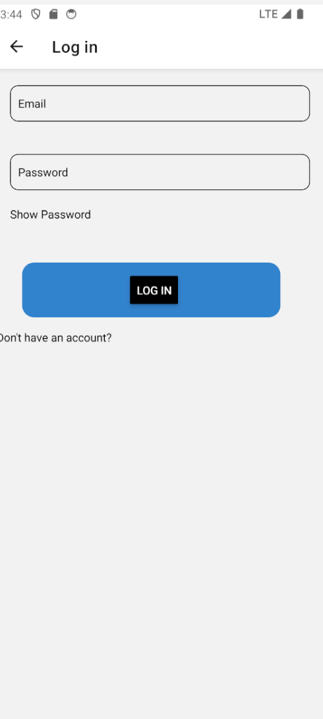
Some Pictures of some screens of the app
Main Screen
Login Screen

Slide 10
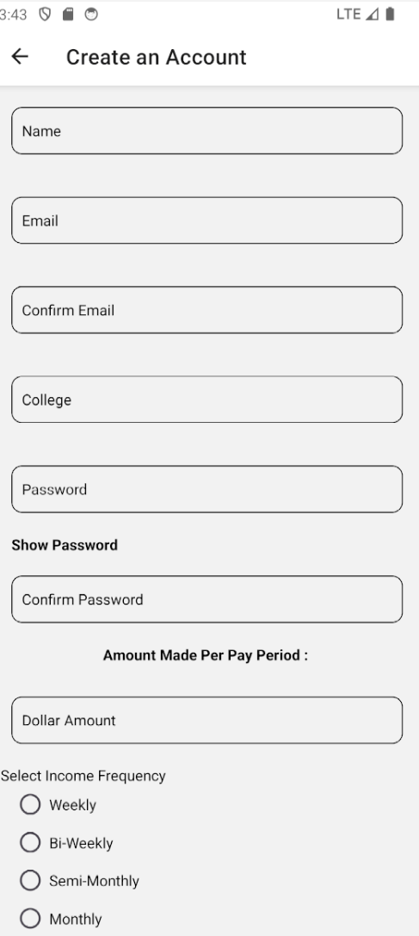
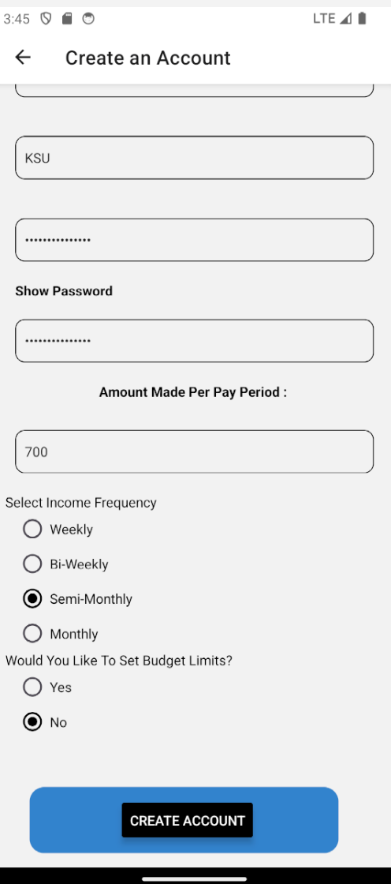
Some More Pictures of some screens of the app
Create an Account Screen
Create an Account Screen Continued

Slide 11
Summary of the App
The student budget app is a simple mobile app for the college student.
It’s a logging system for students that make money to login their expenses into a few predetermined categories fit for the college student, ideally daily, but they’re able to enter expenses any time.
It has four tabs, homepage where they’re able to see their expense distribution among all expenses. Budgeting, where they go to enter in the money that spent on said expense. Resources, where they can go to get information regarding budgeting and general financial information; And finally, profile where they go to see all the information they entered into the create an account page which includes: Fullname, college, email, income amount and pay period.

Slide 12
Demo of the Final app
Youtube link: INDY 12 Student Budget App FinalDemo (youtube.com)

